Slide 1


IT343: Operating System
July – November 2020
Chapter – 1
Basics of Operating System
Devang Patel Institute of Advance Technology and Research

Slide 2
Topic to cover
1. | Introduction
1.1 | What is an OS? Evolution Of OS
1.2 | OS Services
1.3 | Types Of OS
1.4 | Concepts of OS
1.5 | Different Views Of OS

Slide 3
Basic concepts
Software:-
Program is a collection of code/instruction.
Software is a collection of program.
Hardware:-
Physical device is a collection of computer system which is called Hardware.
For example:-processor, RAM,HD,I/O devices.

Slide 4
Types of Software
Software is divide into three types:
System software
Utility software
Application software

Slide 5
System software
The software which is used to perform all types of system level work of the computer system is called system software.
For example:
Compiler
Operating system
Interpreter
Linker
Loader

Slide 6
Utility Software
The software, which provide an additional meaning to the computer system.
For Example:-
Calculator
MS-paint

Slide 7
Application Software
The software which is created by users, using the different high level language and database system for any special purpose.
For Example:-
Library Management
Banking Software

Slide 8
What is an
OPERATING SYSTEM
????

Slide 9
Operating System……..
A program that acts as an intermediary between a user of a computer and the computer hardware
An operating system is a program that manages computer hardware in a very efficient manner.

Slide 10
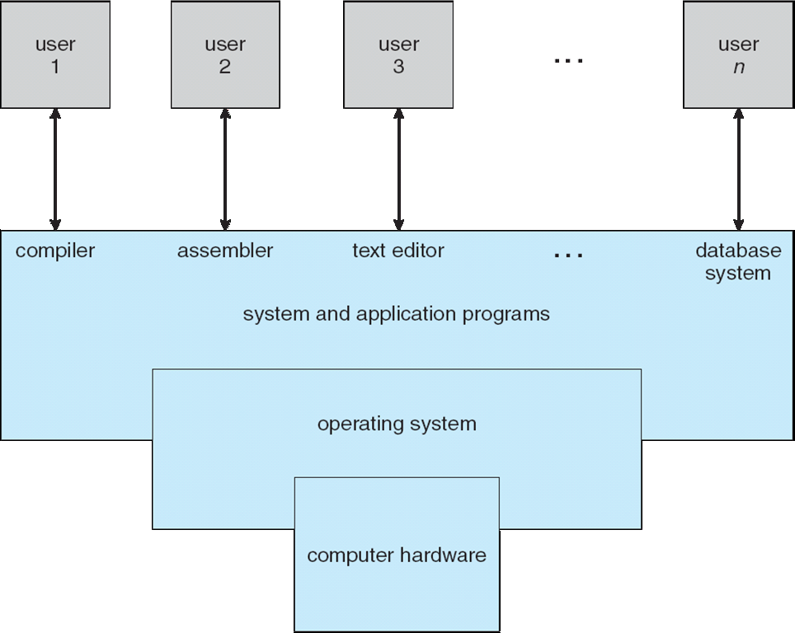
Computer System Structure

Slide 11
Four Components of a Computer System
Hardware
Operating System
Application program
Users

Slide 12
Computer system can be divided into four components
Hardware – provides basic computing resources. For ex: CPU, memory, I/O devices, file storage space
Operating system: Controls and coordinates use of hardware among various applications and users
Application programs – define the ways in which the system resources are used to solve the computing problems of the users
Word processors, compilers, web browsers, database systems, video games.
Users: People, machines (e.g., embedded), other computers

Slide 13
Types of operating system
Batch Operating System
Multiprocessing os
Multiprogramming os
Time-sharing system
Real Time system
Distributed System
Cluster System

Slide 14
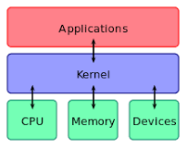
What Is Kernel?

Slide 15
Definition of Kernel
A kernel is a central component of an operating system. It acts as an interface between the user applications and the hardware. The sole aim of the kernel is to manage the communication between the software (user level applications) and the hardware
The main tasks of the kernel are : Process management
Device management
Memory management
Interrupt handling
I/O communication
File system...etc..

Slide 16
Difference between kernel and OS?
Kernel as described above is the heart of OS which manages the core features of an OS while if some useful applications and utilities are added over the kernel, then the complete package becomes an OS. So, it can easily be said that an operating system consists of a kernel space and a user space.

Slide 17
Is LINUX A Kernel Or An Operating System?

Slide 18
operating system is like Government
operating system provide the means for proper use of system resources.
Government also provides facilities to the peoples like providing job opportunities, making new plans for facilities of peoples, solve problems of peoples.
Like a government, OS performs no useful work itself but it provide an environment to use the computer system. So, operating system is similar to government.

Slide 19
Goals of an Operating System
19
Simplify the execution of user programs and make solving user problems easier
Use computer hardware efficiently
Allow sharing of hardware and software resources.
Make application software portable and versatile
Provide isolation, security and protection among user programs
Improve overall system reliability
error confinement, fault tolerance, reconfiguration.

Slide 20
Why should I study Operating Systems?
20
Need to understand interaction between the hardware and applications
New applications, new hardware
Need to understand basic principles in the design of computer systems
efficient resource management, security, flexibility
Increasing need for specialized operating systems
e.g. embedded operating systems for devices - cell phones, sensors and controllers
real-time operating systems – vehicles, aircraft control, multimedia services

Slide 21
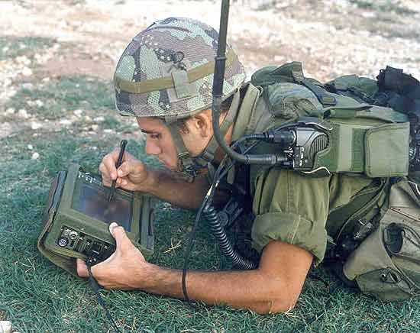
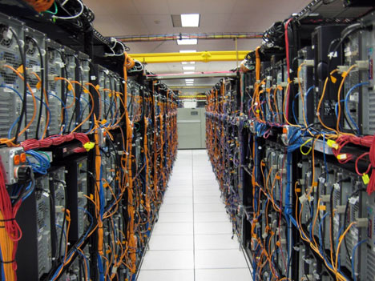
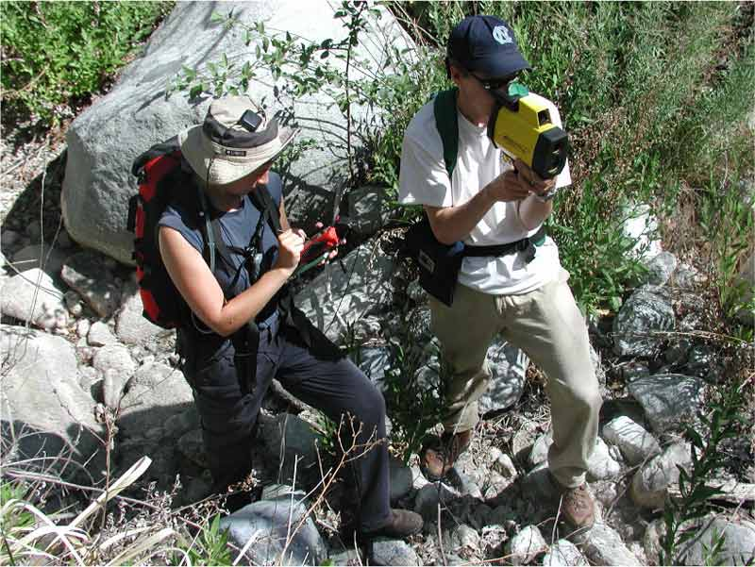
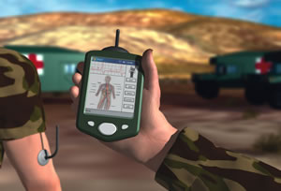
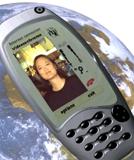
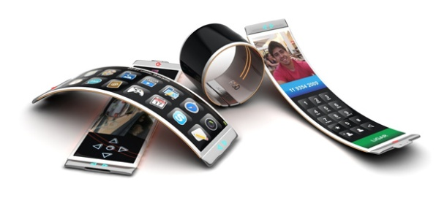
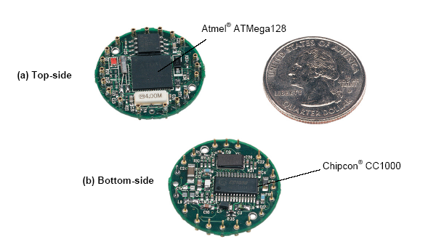
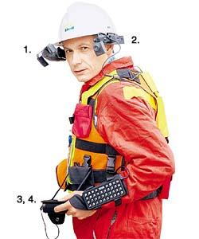
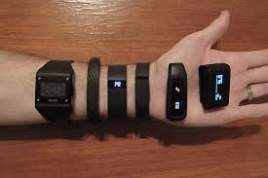
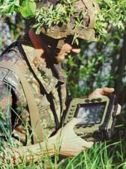

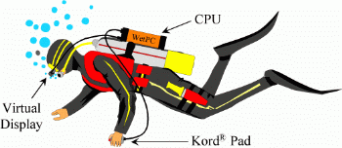

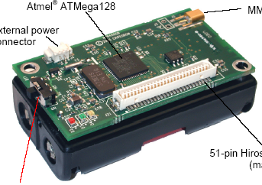
Systems Today and The Future
21
Principles of Operating Systems - Lecture 1

Slide 22
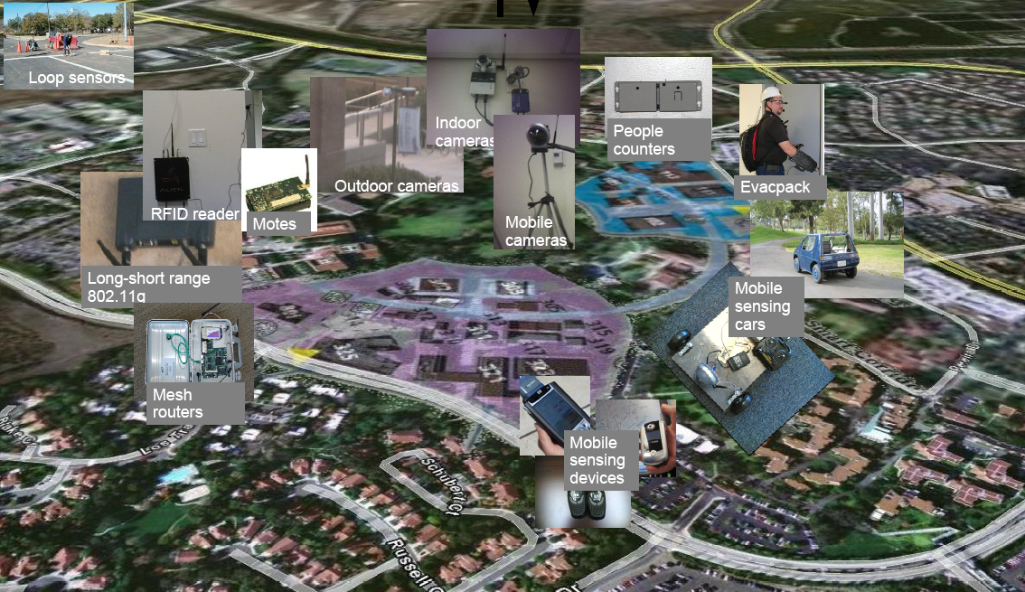
Irvine Sensorium

Slide 23
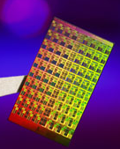
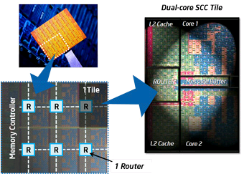
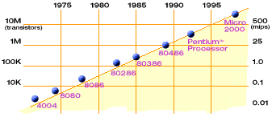
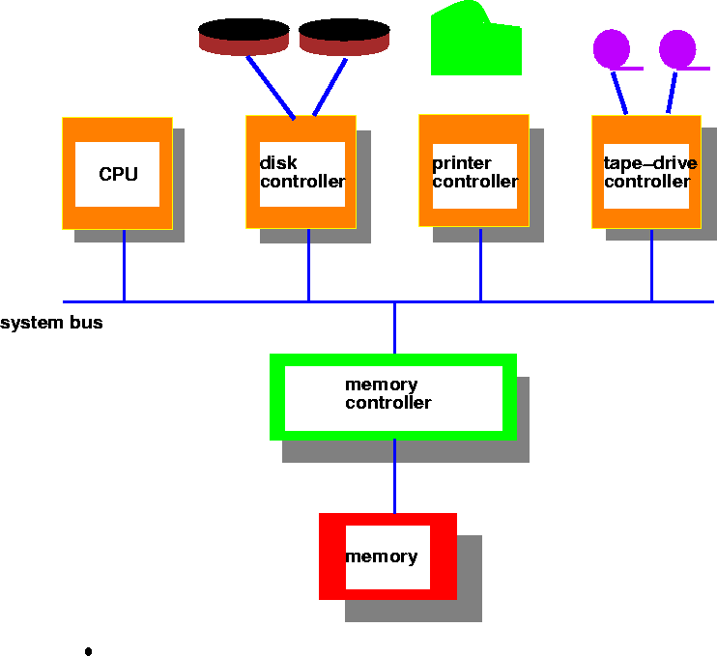
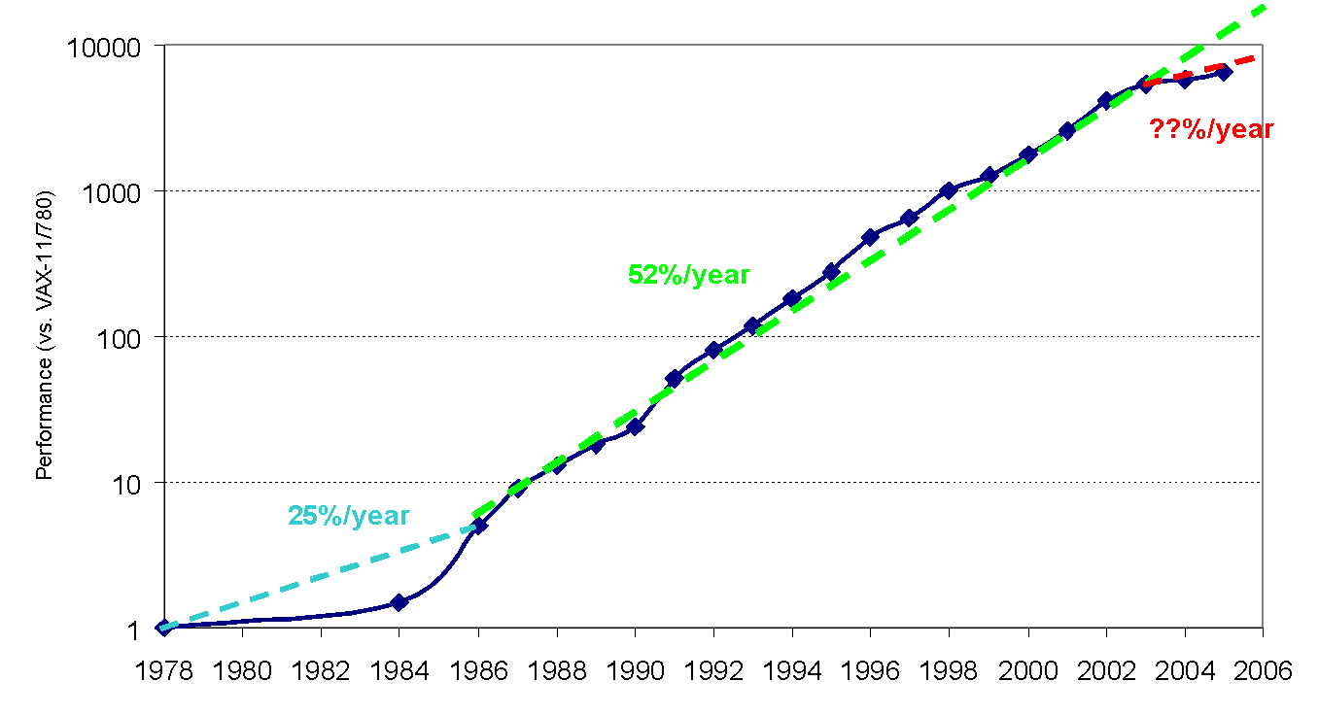
Hardware Complexity Increases
23
Moore’s Law: 2X transistors/Chip Every 1.5 years
From Berkeley OS course
Intel Multicore Chipsets
Moore’s Law
From Hennessy and Patterson, Computer Architecture: A Quantitative Approach, 4th edition, Sept. 15, 2006

Slide 24
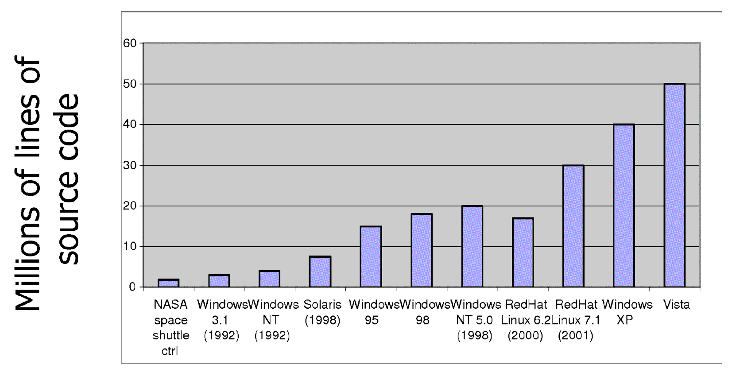
Software Complexity Increases
24
From MIT’s 6.033 course

Slide 25
Definition of Operating System
OS is a resource allocator
Manages all resources (OS as a government allegory)
Decides between conflicting requests for efficient and fair resource use
OS is a control program
Controls execution of programs to prevent errors and improper use of the computer
Resource allocation and control is especially important when having several users connected to the same mainframe or microcomputer

Slide 26
Basic resources of computer system
Following are the resources of computer system, managed and allocated by Operating System:
CPU (Central Processing Unit)/ Process Management
Memory Management
Primary Memory
Secondary Memory
File system
I/o Device

Slide 27
OS as Resource Allocator Process Management
A process is a program in execution. A process needs certain resources, including CPU time, memory, files, and I/O devices, to accomplish its task.
The operating system is responsible for the following activities in connection with process management.
Process creation and deletion.
process suspension and resumption.
Provision of mechanisms for:
process synchronization
process communication

Slide 28
OS as resource allocator Main Memory Management
Memory is a large array of words or bytes, each with its own address. It is a repository of quickly accessible data shared by the CPU and I/O devices.
Main memory is a volatile storage device. It loses its contents in the case of system failure.
The operating system is responsible for the following activities in connections with memory management:
Keep track of which parts of memory are currently being used and by whom.
Decide which processes to load when memory space becomes available.
Allocate and deallocate memory space as needed.

Slide 29
OS as Resource allocator Secondary Storage management
Since main memory (primary storage) is volatile and too small to accommodate all data and programs permanently, the computer system must provide secondary storage to back up main memory.
Most modern computer systems use disks as the principle on-line storage medium, for both programs and data.
The operating system is responsible for the following activities in connection with disk management:
Free space management
Storage allocation
Disk scheduling

Slide 30
OS as resource allocator I/o System Management
The I/O system consists of:
A buffer-caching system
A general device-driver interface
Drivers for specific hardware devices

Slide 31
OS as resource allocator File Management
A file is a collection of related information defined by its creator. Commonly, files represent programs (both source and object forms) and data.
The operating system is responsible for the following activities in connections with file management:
File creation and deletion.
Directory creation and deletion.
Support of primitives for manipulating files and directories.
Mapping files onto secondary storage.
File backup on stable (nonvolatile) storage media.

Slide 32
OS as control program Protection System
Protection refers to a mechanism for controlling access by programs, processes, or users to both system and user resources.
The protection mechanism must:
distinguish between authorized and unauthorized usage.
specify the controls to be imposed.
provide a means of enforcement.

Slide 33
Example – MS-Paint over Windows
Assume we are using MS-Paint over Windows - when do we need to access the OS?
Loading the application / terminating the application
Memory allocation / management (e.g., paging)
Access to IO devices – keyboard, mouse, printer, monitor
CPU allocation
Copy / Paste (inter-process communication)

Slide 34
Thank You

